Slide 1

FulcrumQ Overview
The Talent to Value company

Slide 2




FulcrumQ – The Talent to Value Company
A Global Talent & Management Advisory Firm
Mobilizing Value with a Talent Edge
FulcrumQ ADVISORY
Talent to Value ACADEMY
FulcrumQ DIGITAL
FulcrumQ CAPITAL
Human Capital Diligence
Enabling capability transfer to your organization
A customized training and apprenticeship model
Mobilizing Talent to Value through a suite of digital tools and dashboards
Agentic AI based toolset to enhance client productivity and insights
Co-investing in Talent-led transformations at a Portfolio Company and/or fund-level
C-Suite Selection
Leadership Assessment
Talent to Value Plans
Org Design & Op Model

Slide 3

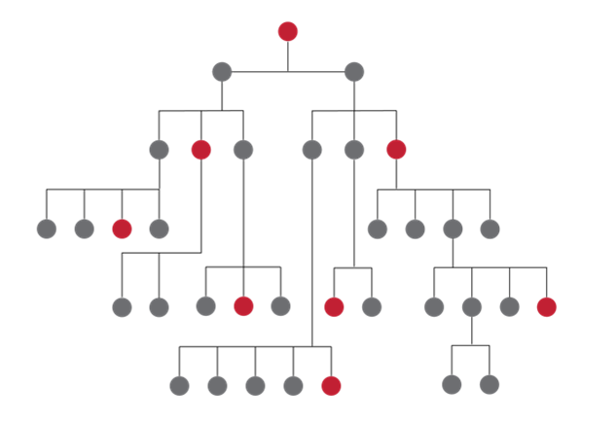



Talent to Value: Gets the Strategy Moving Faster
Value Creating work
“Jobs to be Done”
Success at points of Leverage
Pinpoint Risks to
Critical Roles
Value is the unit of Measure
Constrained by focus – not supply
Talent at the same altitude as strategy

Slide 4

Why Talent to Value: CEO Success
In Private Equity
In S&P500 Companies
WE LOOKED AT
80 Investments Backward
100 Investments Forward
6 Yrs
2x
4.8 Yrs
2.2
Years
56%
2013
2023
20% decline in
tenures*
CEO’s exited
in the first 2 years
2019 - 2024
Average time
to replacement
Failure Rate
80%
Transformations on the new curve within first 12-18 Months
43%
Execs say 2025 was harder than 2024
* Equilar CEO Tenure Study
** Russell Reynolds Global CEO Turnover Index
** World Economic Forum

Slide 5

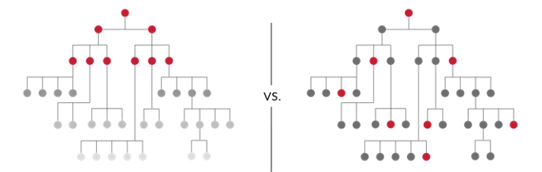



CEO Success Rates Are Low Due to 3 Key Derailers
1
2
3
DOING TOO MUCH
PICKED THE WRONG PEOPLE
NOT ENOUGH TALENT
AT THE PROBLEM
Think BIG
Capital
Investments
=
Evidence Based
Risk Aware
Talent
Investments
=
Opinion Based
Risk Blind
VS.
Start BIG
Move s...l...o...w
“Prove me wrong”
“Fall in Love”
Hierarchy
Connected to Value
Starting more initiatives than there is capacity
Not aligning selection to value
Not factoring risks in role design and operating model
Focusing only on “top” roles
Not understanding and investing in (level-agnostic) roles critical to value creation

Slide 6
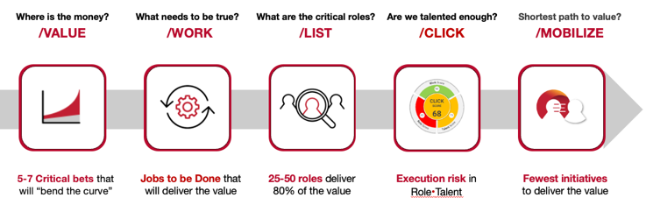
Our Approach Connects Talent Decisions to Value
We Ask Five Critical Talent Questions
01
Are we aligned on the value pools and big bets which will drive value?
02
Do we know the critical roles that will deliver 80% of the value?
03
Is the organization designed for success?
04
What are the few new capabilities needed to enable value delivery?
05
Have we built a minimally invasive plan to enable success?

Slide 7
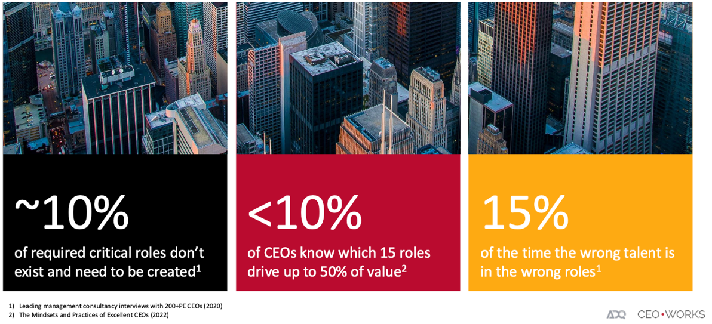
IT Sounds Simple but Most People Don’t Do IT
50%
of critical roles in organizations are not set-up to succeed
70%
of execution risks sit beyond the talent skills
71%
PE CEOs are replaced sometime during the hold period
1) Leading management consultancy interviews with 200+ PE CEOs (2020)
2) The Mindsets and Practices of Excellent CEOs (2022)
2022 HBS
The Market for CEOs: Evidence from PE

Slide 8
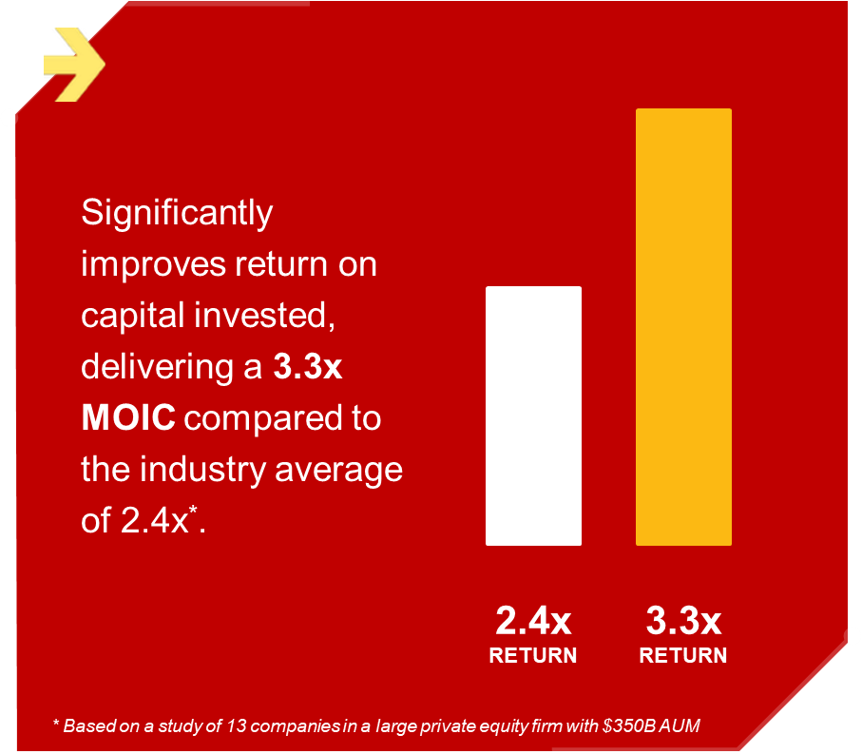

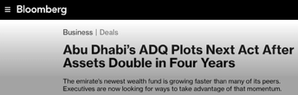
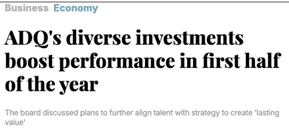

Consistent Excellence Delivers Outsized Outcomes
2X
Better ROI for those that get talent right in the first year
2025
4X
Return on An Exit, 6 years Partnership with us A large European PE company
6X
Return, Where Talent to Value Refreshed Every Year
A premier mid-market US PE company

Slide 9





Talent to Value in 4 Key Areas to Address CEO Questions
Where is the
money?
How do I want
to run the place?
Is my leadership team ready?
Do we have
enough talent
at our critical roles?
Are we
mobilizing for success?
Human Capital Due Diligence
Talent to Value Plans for PortCos
C-Suite Selection and Leadership Assessment
Capability Building (CEOs, CXOs, PE Partners)

Slide 10

























































































Our Clients
PRIVATE EQUITY
PROFESSIONAL SERVICES
RETAIL/ONLINE RETAIL FORUM
HEALTHCARE/HEALTH TECHNOLOGY
FINANCIAL SERVICES
MEDICAL DEVICES
ENERGY & INDUSTRIAL
IT SERVICES
OTHER
PHARMECEUTICALS AND LIFE SCIENCES
EDUCATION
CONSUMER PACKAGED GOODS
INSURANCE

Slide 11

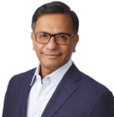


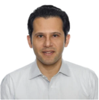

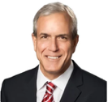

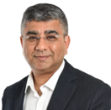
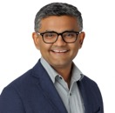





Our Practitioner-led Global Team
Shefali Salwan
Co-Founder
Sumeet Salwan
Co-Founder
Joydeep Mutsuddi
Senior Partner, US
Jeroo Dalal
Partner, India
Tim Burns
Partner, US
Alex Kopitsas
Senior Partner,
Middle East & Africa
Bill Allen
Senior Partner, US
Jim Nolten
Partner, Middle East
Rajev Shukla
Senior Partner,
Asia & Middle East
Prateek Sinha
Partner, Europe
Dhaval Bhagat
Partner, US
Daniella Patrick
Associate Partner, US
Vikram Ekambaram
Head of Digital Products
Vandana
Vaidyanathan
Associate Partner, US
Steve Courington
GM of Capability
Austin Riggs
Associate Partner, US
NEW YORK | AMSTERDAM | DUBAI | SINGAPORE | MUMBAI

